Slide 1
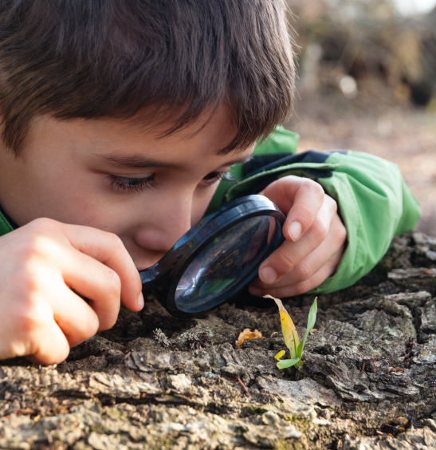
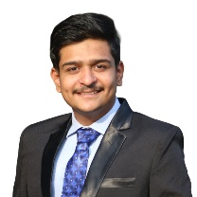

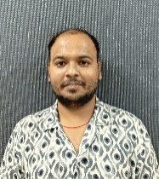
CT Image Denoising
PID_1544
Jeet Nakrani
Mayank Kathane
Shubham Vishwakarma
College Name - Mukesh Patel School of Technology, Management and Engineering (NMIMS), Mumbai

Slide 2
Challenge Statement
Understanding the Problem
In medical imaging, particularly brain CT scans, image quality is often compromised by two prevalent types of noise:
Poisson Noise:
Originates from the statistical nature of photon detection during image acquisition.
Periodic Noise:
Caused by interference from electronic and mechanical components in the CT scanner.
Challenge Requirement
The objective is to develop a software tool capable of:
Reading and displaying CT brain scans in DICOM format.
Designing an algorithm that reduces Poisson and periodic noise effectively.
Enhancing image clarity while preserving essential diagnostic information, leading to more accurate diagnoses.
1544

Slide 3

Concept / Scope of solution
Autoencoder Architecture: The use of a denoising autoencoder that learns both spatial and feature representations of CT images is an innovative approach, enabling automatic noise removal while preserving critical image details for diagnosis.
DICOM Integration: Handles CT scans in their native DICOM format, maintaining medical data integrity.
Medical Diagnostics: Enhances clarity in CT scans for better detection of pathologies such as tumors, hemorrhages, or structural anomalies in the brain.
Adaptability & Scalability: Potential to extend the solution to other imaging modalities (e.g., MRI) or apply it to real-time CT imaging workflows.
Glioma Tumour
Meningioma Tumour
No Tumour
Pituitary Tumour
Dataset contains 4 classes
Dataset
1544

Slide 4
Feedback from Presentation Round and its Use
GUI – User-Friendly: Implemented an intuitive interface for easy navigation and better user engagement
Minimal Loss in CT Scan Images: Ensured high-quality image handling through optimized compression and error-free data processing
Deployment: Streamlined solution deployment across multiple platforms, enabling wider accessibility
Multiple Images Upload: Added batch upload functionality for handling multiple images simultaneously
Download Option: Provided a direct download feature for results, enabling offline review and further analysis
1544

Slide 5

SWOT Analysis
STRENGTH
WEAKNESS
High-quality noise reduction (Poisson & periodic noise)
DICOM compatibility for seamless integration
Automated & efficient – reduces manual intervention
Scalable – adaptable to MRI, ultrasound, etc.
High computational demand (requires GPUs)
Data dependency – needs large, high-quality datasets
Potential artifacts – risk of altering critical medical details
OPPORTUNITIES
THREATS
Integration with PACS (Picture Archiving and Communication System) & hospitals
Real-time processing with optimized models
Expansion to other medical imaging modalities
Regulatory & ethical concerns (HIPAA, GDPR)
Resistance to AI adoption by radiologists
Competitor AI-based solutions in medical imaging
1544

Slide 6
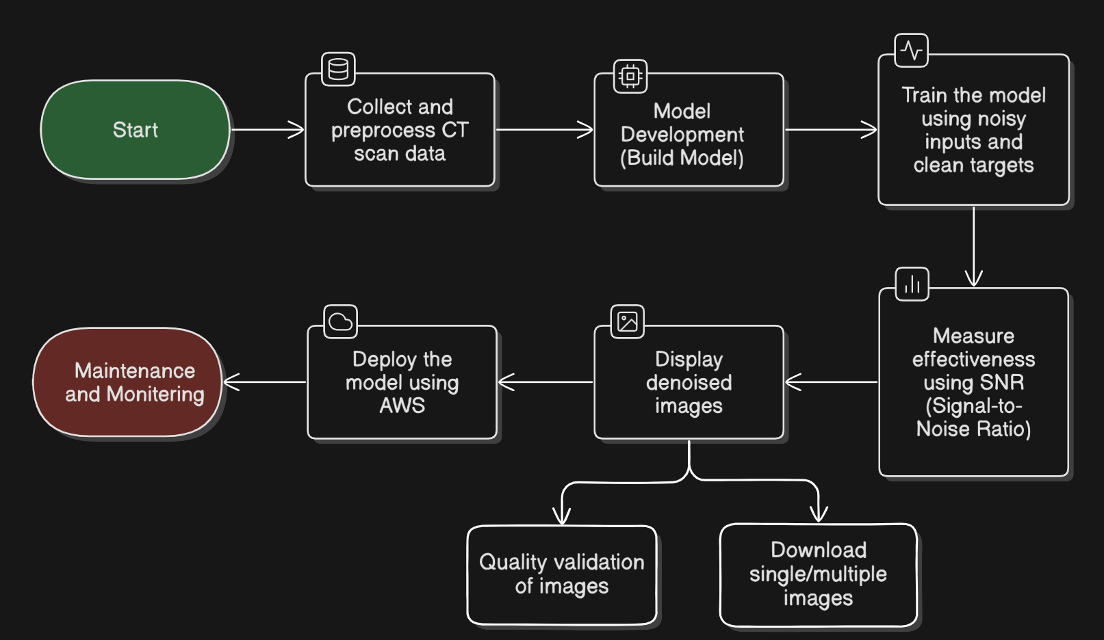
Implementation (1/2)
1544

Slide 7
Implementation (2/2)
Conv2D (Encoder)
Conv2D (Encoder)
Conv2D (Decoder)
UpSampling2D
Conv2D (Decoder)
Conv2D (Output)
MaxPooling2D
Encoder
Decoder
Reduces spatial dimensions while retaining essential features
Extracts low-level features
1544

Slide 8
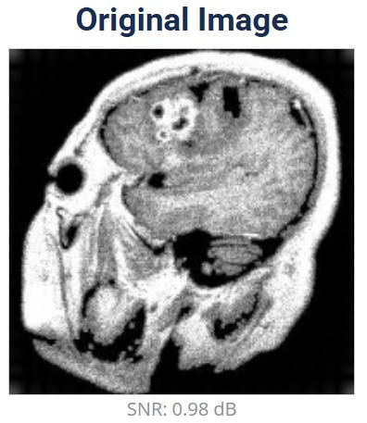
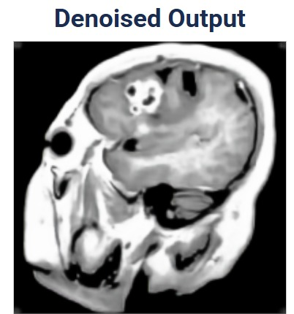
Testing / Analysis (1/2)
SNR: 0.98 dB
SNR: 18.91 dB
SNR Improvement: Increased from 0.98 dB (original) to 18.91 dB, enhancing image quality
1544

Slide 9
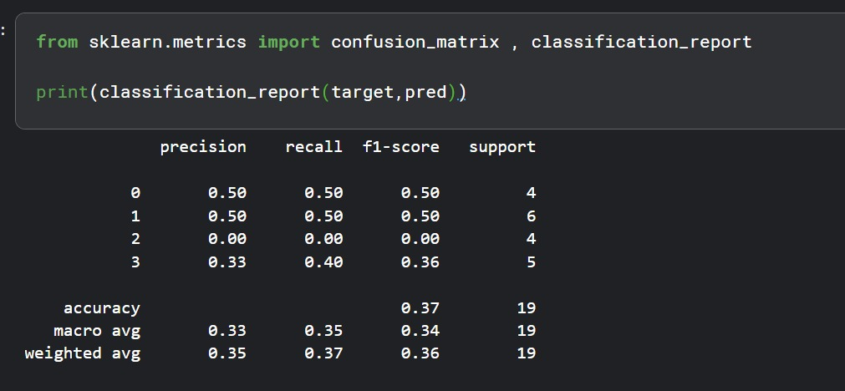
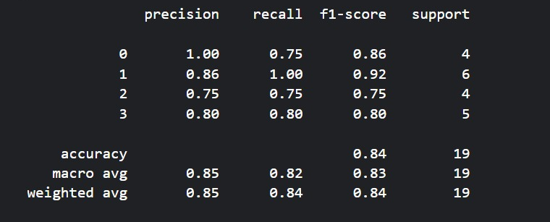
Testing / Analysis (2/2)
Noisy Image
Denoised Image
Denoising Evaluation: Processed 19 noisy CT scan images through the model, resulting in increased SNR, indicating improved image quality.
Disease Prediction Validation: Developed a separate classification model to predict disease presence and type using both noisy and denoised images.
Performance Comparison: Generated a classification report comparing model accuracy on noisy vs. denoised images.
Key Insight: The model extracts features more effectively from denoised images, leading to better classification accuracy and improved disease prediction.
1544

Slide 10

POC Demo
1544

Slide 11
High Level plan for converting POC to MVP
1544

Slide 12
Cost for POC vs MVP
1544

Slide 13
Cost for POC vs MVP
1544

Slide 14
Result / Conclusion
1544

Slide 15
References
List of research papers or articles on CT image denoising, Autoencoders, and related deep learning techniques.
Larrue, Tara, etal.”Denoising Videos with Convolutional Autoencoders.”(2018).
Xie, Junyuan,LinliXu, and EnhongChen. ”Image denoising and in painting with deep neural networks.”Advances in neural information processing systems. 2012.
Dabov, Kostad in , etal. ”BM 3D image denoising with shape-adaptive principal component analysis.”SPARS’09-Signal Processing with Adaptive Sparse Structured Representations.2009.
Image Denoising based on Deep Learning – Zeyu Li https://drive.google.com/file/d/1sJKonZFW6PhQg4-AKRriazfPnhD1v_m3/view
Brief review of image denoising techniques - Linwei Fan1,2,3, Fan Zhang2,Hui Fan2 and Caiming Zhang1,2,3 - https://drive.google.com/file/d/1TA43lQucTmFZyyxK1AGY5-3-pwXDB7yq/view
Reference to any medical imaging databases used (e.g., Kaggle).
TensorFlow/Keras Documentation for model implementation.
Dataset - https://www.kaggle.com/datasets/sartajbhuvaji/brain-tumor-classification-mri
Image References: - https://artificialpaintings.com/blog/2024/06/14/ai-in-medical-diagnostics-empowering-healthcare-with-precision-and-efficiency/ , https://kingsmedical.com/blog/understand-the-differences-between-ct-and-mri/
1544

Slide 16

THANK YOU

Slide 17
Fact | Why It Matters
🌡️ Global warming has already exceeded 1.1°C | We're nearing the 1.5°C danger threshold set by the Paris Agreement.
🌳 1 mature tree absorbs only 22 kg of CO₂/year | So it takes ~220 trees to absorb 1 person’s annual emissions.
🚗 Driving 1 km = ~0.25 kg of CO₂ | Simple reference to help people connect habits to impact.
📈 At this pace, emissions may exceed 40 billion tons/year by 2030 | Shows urgency and future risk.
🔁 72% of global emissions come from energy use (heating, cooling, lighting, mobility) | Makes your energy-centric sectors even more relevant.
Metric | Value
Total Emissions (2022) | 635.5 million tons of CO₂
Year-on-Year Change | −1.15% (a decrease of ~7.4 million tons)
Share of Global CO₂ Emissions | 1.65%
Population (2022) | 51.78 million
Per Capita CO₂ Emissions | 12.27 tons/person

Slide 18
Challenge | Why It Matters
No Incentive Loop | Without rewards, recognition, or competition, adoption rates stay low.
Cultural & Social Pressure | People may feel judged for carrying eco kits, saying no to meat, or biking to work.
Lack of Unified Platform | Citizens often don’t know where or how to start tracking or acting.

Slide 19
What We Measure | How We Measure It
Household electricity/water/gas reduction | Compare monthly utility bills (pre & post participation)
CO₂ saved per action | Use standardized emission factors (e.g., 1 km walk = 0.25 kg CO₂ saved)
Participation in green activities | App check-ins, QR code scanning at events, household pledge forms
Food, waste, and transport choices | Surveys + in-app logging of meals, travel modes, waste bins
Solar panel & LED adoption | Citizen-submitted installation proof or invoices via partner platforms
What We Observe | How We Capture It
Habit Change Over Time | Pre/post behavior surveys (monthly)
Awareness Growth | In-app quizzes, climate literacy scores
Community Engagement | Event participation, pledges, uploads from clean-up or workshops
Testimonials & Feedback | Citizen stories, local leader highlights, video/photo submissions

